Slide 1










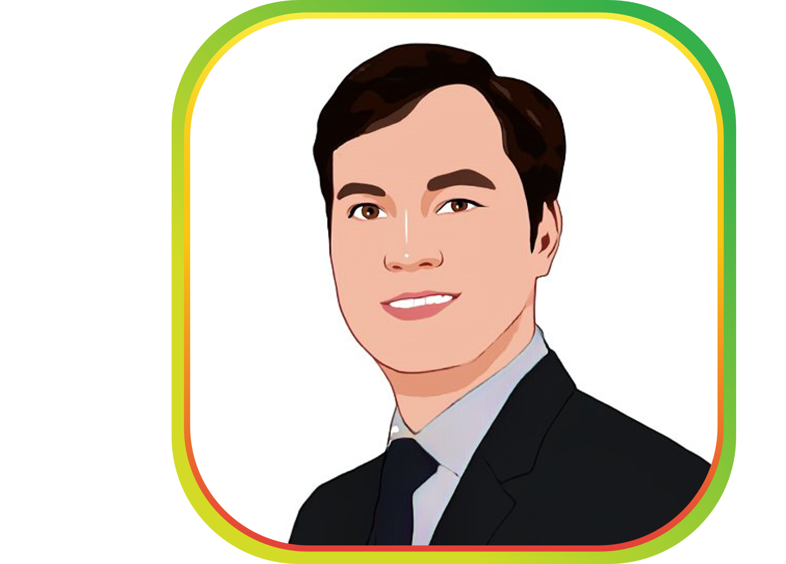
Team
CEO – Devin Rumer
CMO - Robet Pham
CTO – Lucid Hoang
CM – Justin Nguyen
COO - Yunmei Ying
CPO - Duca Nguyen
SA - Robert Nguyen

